Slide 1
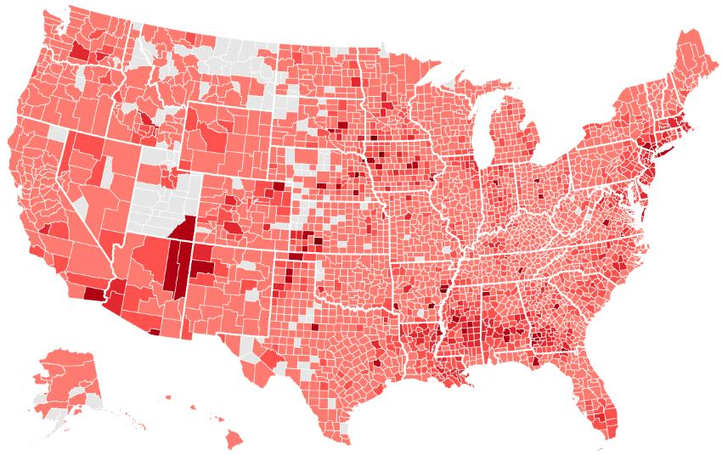
COVID19 Data Analysis of United States
Basira Shirzad

Slide 2
Goal
The New York Times' county-level COVID-19 database was shared to the public with latest data on the number of cases and deaths of all states from January 2020 to the present date.
Our goal is to use this data and analyze the states that had a high number of COVID19 cases and deaths by comparing the daily count of new cases and new deaths and showcasing the beginning and recent data.
For information about the data, see https://github.com/nytimes/covid-19-data.

Slide 3

Environment Set Up
Import all required libraries that are needed for data analysis

Slide 4
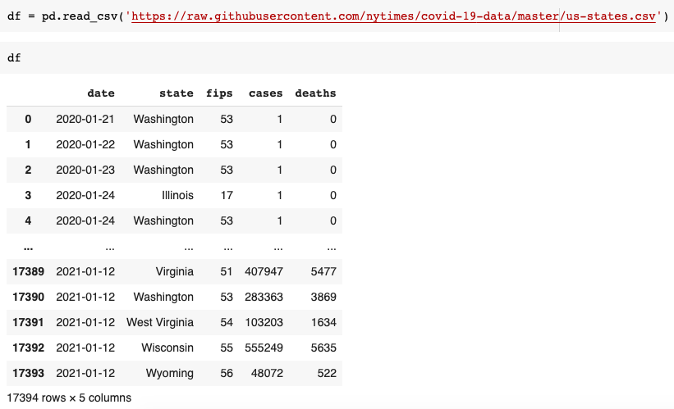
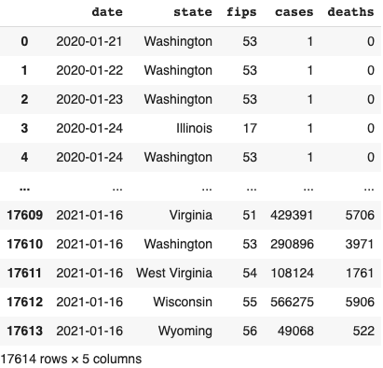

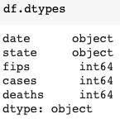

Data Collection
Used the nytimes github repository as a data source to collect the covid 19 data in real time

Slide 5
Data Wrangling & EDA
Enriching the data frame by adding columns that include data on new covid 19 cases and deaths on daily basis (new cases added everyday)

Slide 6
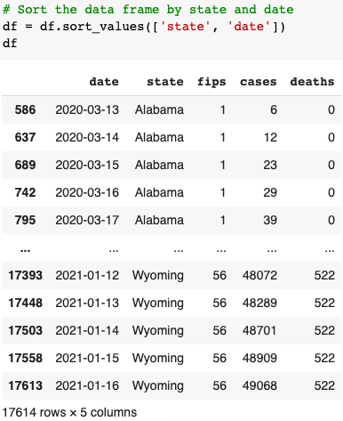
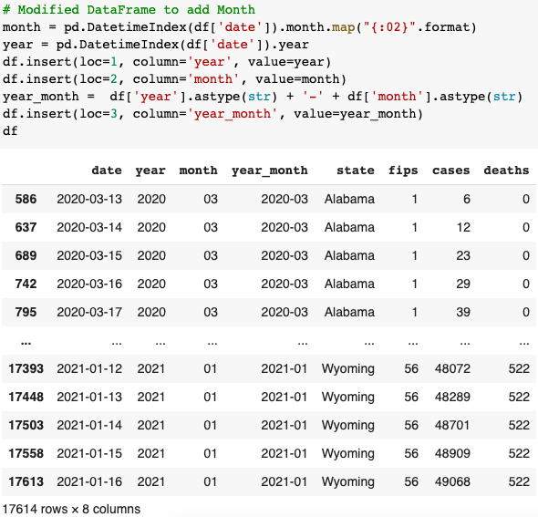
Data Wrangling & EDA

Slide 7
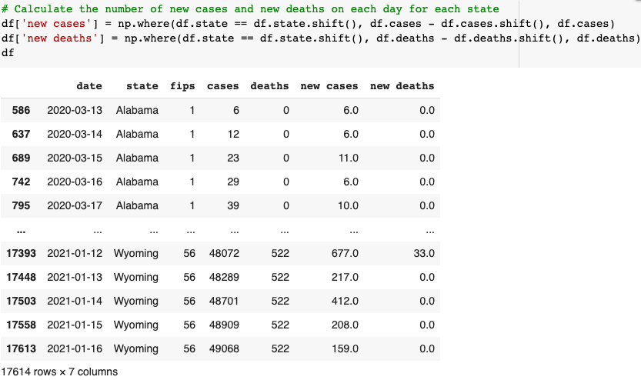
Data Wrangling & EDA

Slide 8
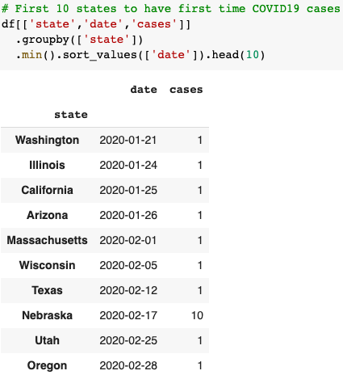
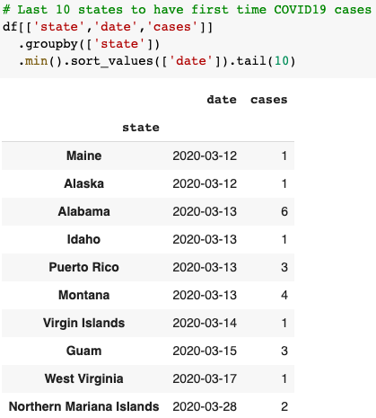
Data Wrangling & EDA
Analyzing COVID19 cases in all states

Slide 9
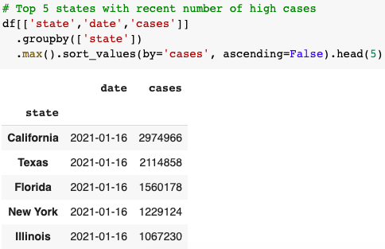
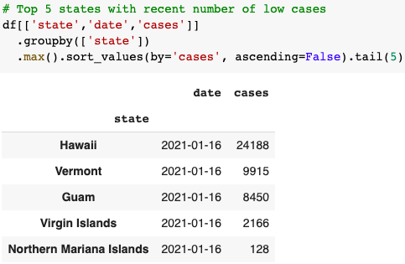
Data Wrangling & EDA
Analyzing COVID19 cases in all states

Slide 10
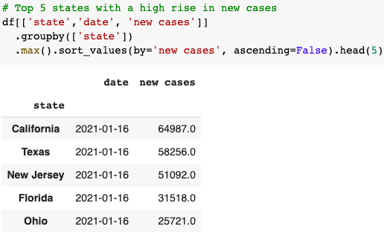
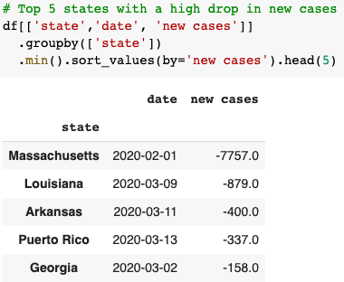
Data Wrangling & EDA
Analyzing COVID19 cases in all states

Slide 11
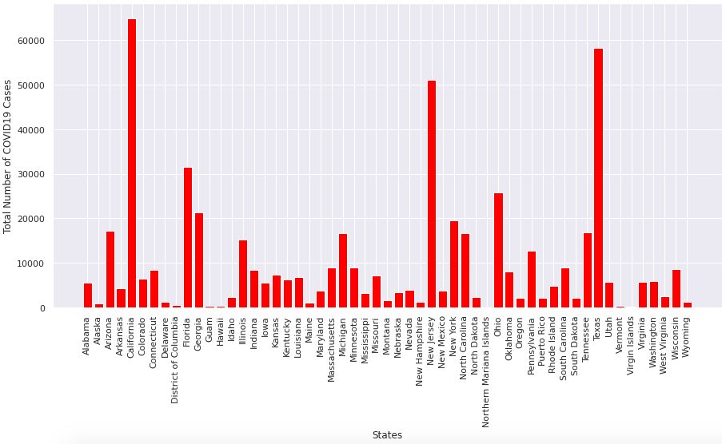
Data Wrangling & EDA
Total Number of COVID19 Cases per State

Slide 12
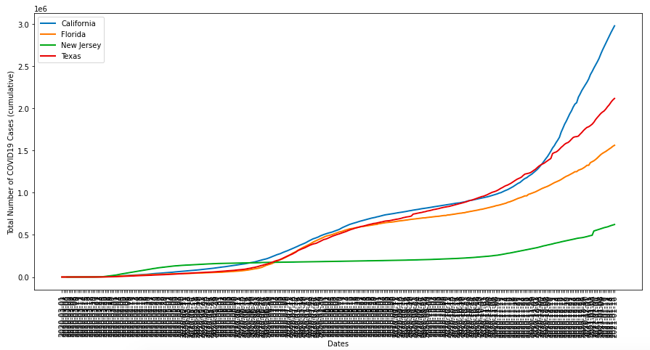
Data Wrangling & EDA
Covid19 Cases in High Risk States

Slide 13
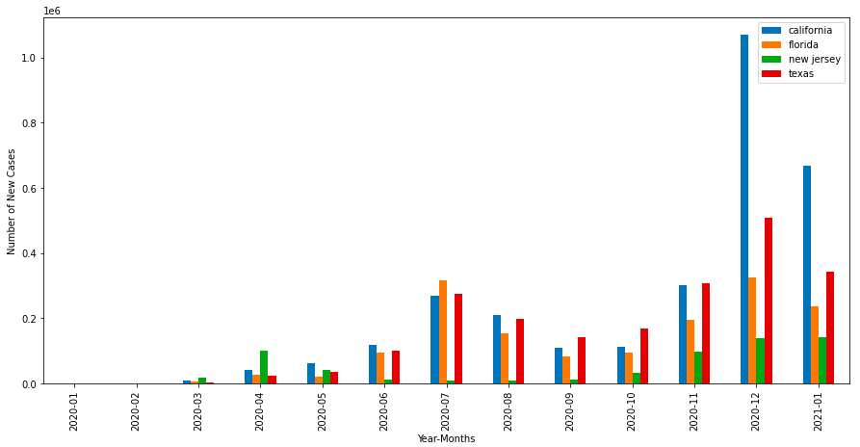
Data Wrangling & EDA
Covid19 Cases per Month in High Risk States

Slide 14
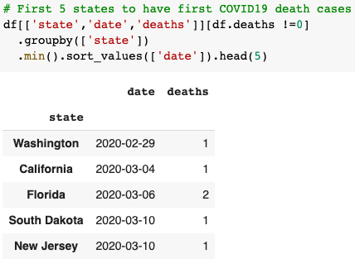
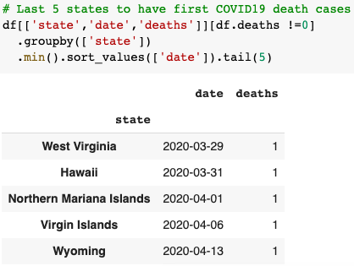
Data Wrangling & EDA
Analyzing COVID19 death cases in all states

Slide 15
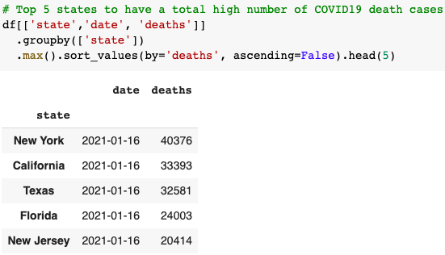
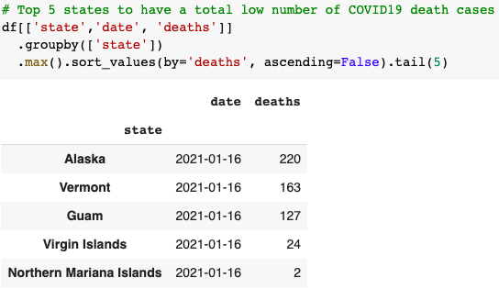
Data Wrangling & EDA
Analyzing COVID19 death cases in all states

Slide 16
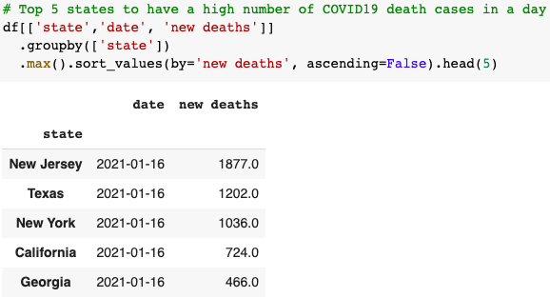
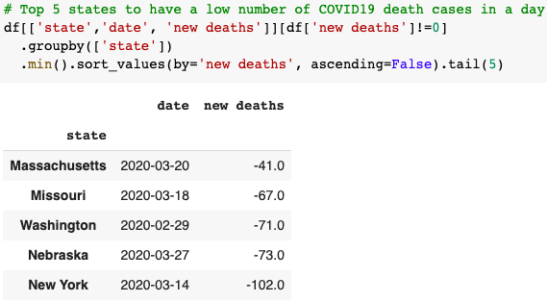
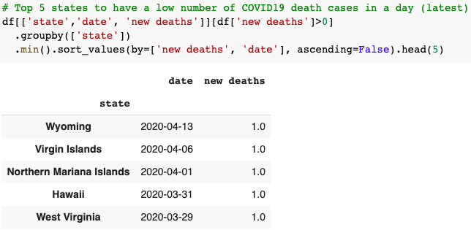
Data Wrangling & EDA
Analyzing COVID19 death cases in all states

Slide 17
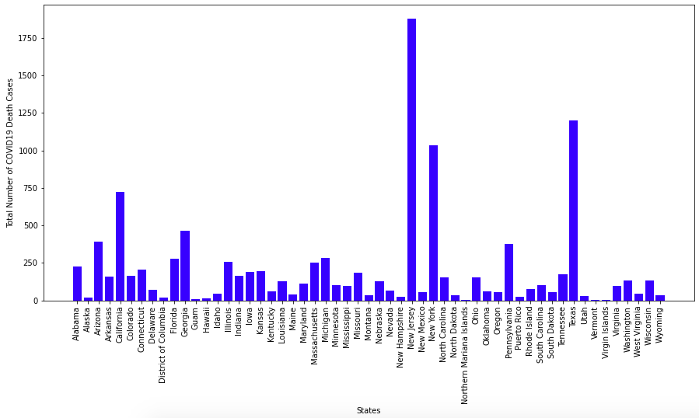
Data Wrangling & EDA
Total Number of COVID19 Death Cases per State

Slide 18
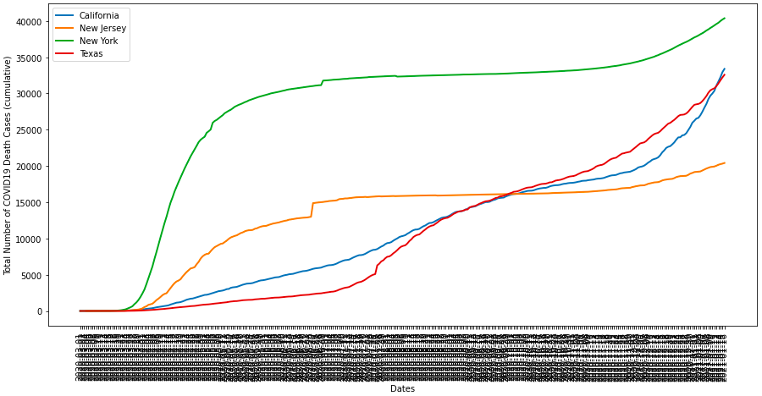
Data Wrangling & EDA
Covid19 Death Cases in High Risk States

Slide 19
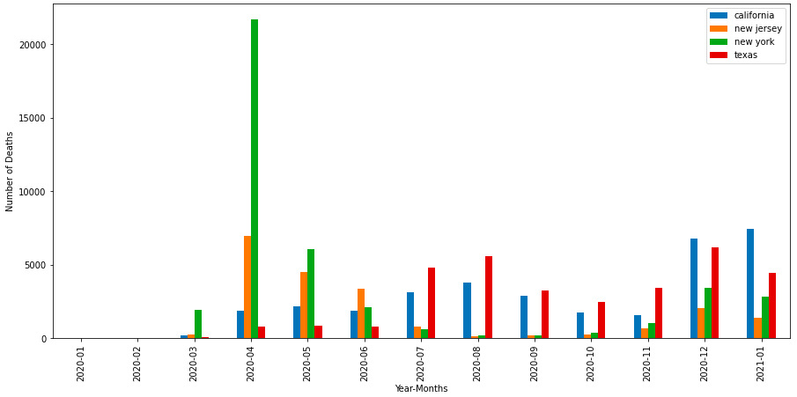
Data Wrangling & EDA
Covid19 Death Cases per Month in High Risk States

Slide 20
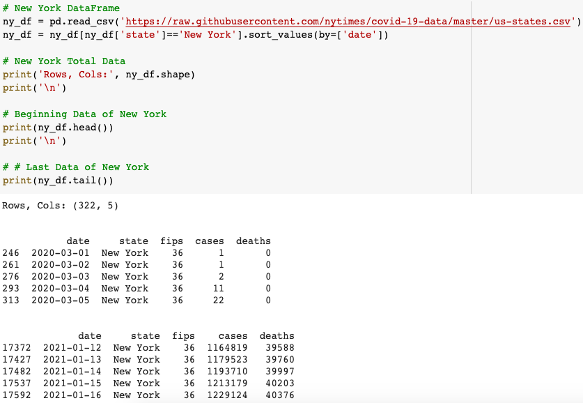
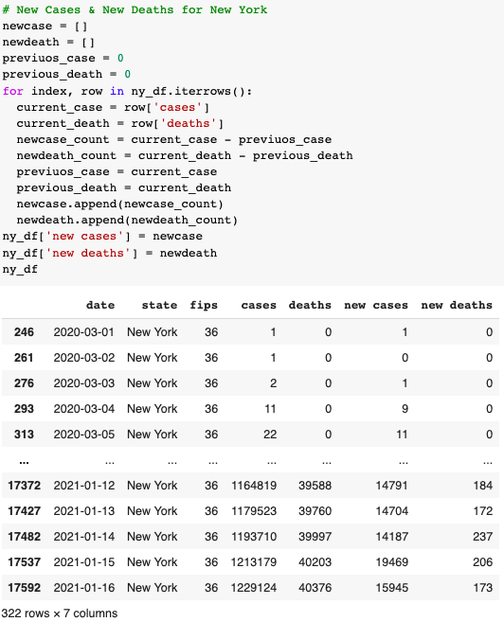
Data Wrangling & EDA
Analyzing New York's data for Covid 19

Slide 21


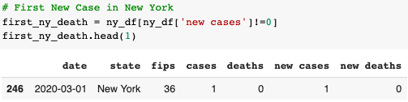
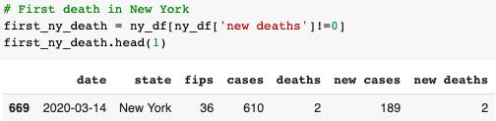
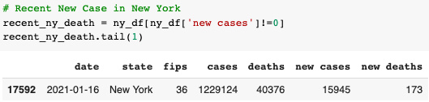
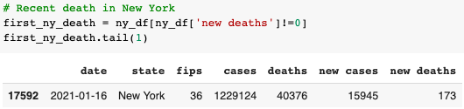
Data Wrangling & EDA
COVID19 New Cases/Death in New York

Slide 22
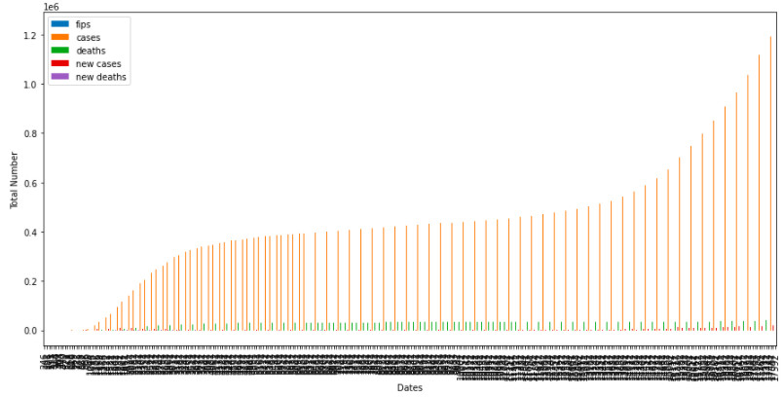
Data Wrangling & EDA
Total Number of COVID19 Cases/Deaths in New York

Slide 23
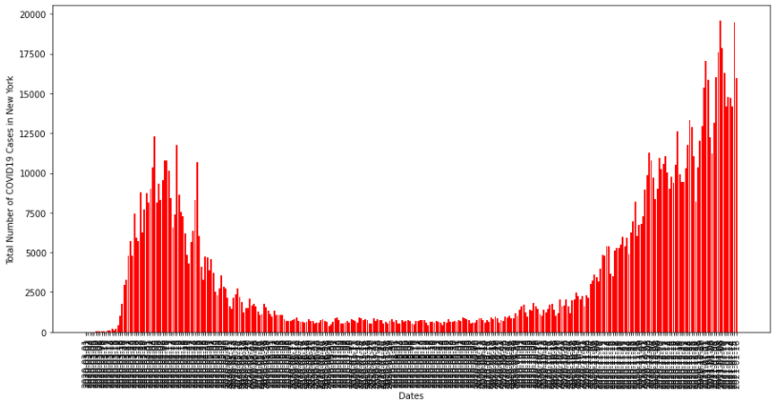
Data Wrangling & EDA
Total Number of COVID19 Cases in New York

Slide 24
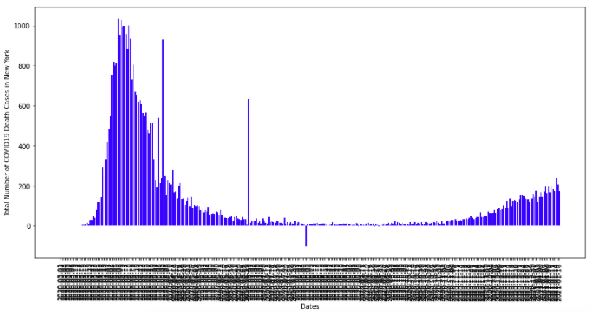
Data Wrangling & EDA
Total Number of COVID19 Death Cases in New York

Slide 25
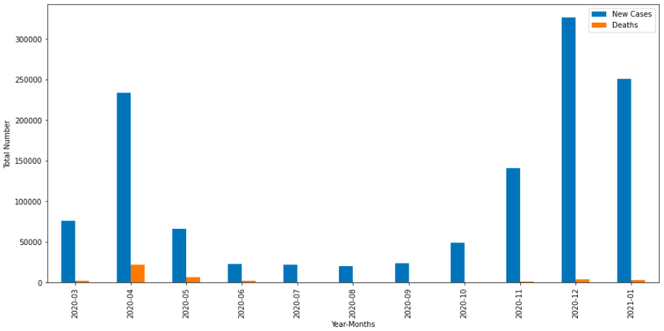
Data Wrangling & EDA
Total Number of COVID19 Death Cases in New York

Slide 26
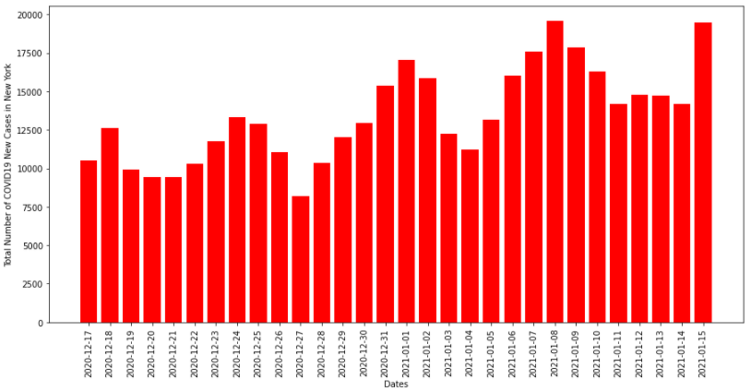
Data Wrangling & EDA
Total Number of COVID19 Cases in New York (last 30 days)

Slide 27
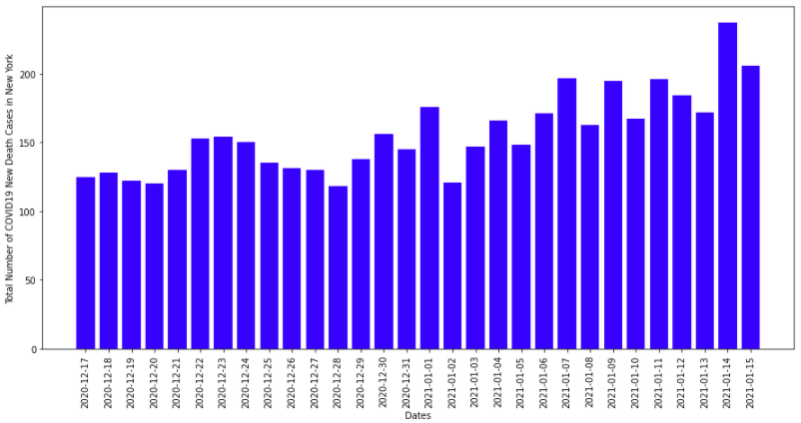
Data Wrangling & EDA
Total Number of COVID19 Death Cases in New York (last 30 days)

Slide 28
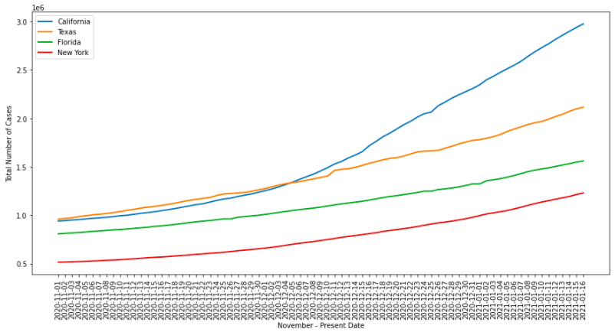
Data Wrangling & EDA
Total Number of COVID19 Cases in states with large populations

Slide 29
Findings
First ten states to have first time COVID19 cases:
Washington, Illinois, California, Arizona, Massachussets, Wisconsin, Texas, Nebraska, Utah, Oregon
Last ten states to have first COVID10 cases:
Maine, Alaska, Alabama, Idaho, Puerto Rico, Montana, Virgin Islands, Northern Mariana Islands
Top 5 states with recent number of high cases:
California, Texas, Florida, New York, Illinois
Top 5 states with recent number of high cases:
California, Texas, Florida, New York, Illinois
Top 5 states with recent number of low cases:
Hawaii, Vermont, Guam, Virgin Islands, Northern Mariana Islands

Slide 30
Findings
Top 5 states with a high rise in new cases:
California, Texas, New Jersey, Florida, Ohio
Top 5 states with a high drop in new cases:
Massachusetts, Louisiana, Arkansas, Puerto Rico, Georgia
California, Florida, New Jersey, and Texas are states that have a high number of cases.
California’s highest was in December 2020
Florida’s highest was in July 2020
New Jersey’s highest was in December 2020
Texas’s highest was in January 2021
First five states to have first COVID19 death cases:
Washington, California, Florida, South Dakota, New Jersey

Slide 31
Findings
Last four states to have first COVID19 death cases:
West Virginia, Hawaii, Northern Mariana Islands, Virgin Islands
Top five states to have a total high number of COVID19 death cases:
New York, California, Texas, Florida, New Jersey
Top five states to have a total low number of COVID19 death cases:
Alaska, Vermont, Guam, Virgin Islands, Northern Mariana Islands
Top five states to have a high number of COVID19 death cases in a day:
New Jersey, Texas, New York, California, Georgia
Top five states to have a low number of COVID19 death cases in a day:
Wyoming, Virgin Islands, Northern Mariana Islands, Hawaii, West Virginia

Slide 32
Findings
California, New Jersey, New York, and Texas are states with a high number of death cases with New York being the state with the largest deaths
California had the largest death in January 2021
New Jersey had the largest death in April 2020
New York had the largest death in April 2020
Texas had the largest death in December 2020
New York
Beginning Date: 03-01-2020
Total Cases: 1
Total Deaths: 0

Slide 33
Findings
Cases on date: 1
Deaths on date: 0
Recent Date: 01-16-2021
Total Cases: 1,229,124
Total Deaths: 40,376
Cases on date: 15,945
Deaths on date: 173
New York has a higher number of cases from December to now, but less death cases compared to spring time.
The larger the population of a state, the more COVID19 cases.

Slide 34
Conclusions
Overall, states with the most population seem to have a high rise in COVID19 cases. However, it was interesting to see that even though New York was not considered to have a high number of cases compared to other states, it had the most deaths in the early stage. A possible answer to this may be because of the lack of readiness in hospitals and poor regulations by the state. New York seems to be doing much better now as the number of cases rise with very few death cases. However, it is still the state with the highest number of deaths. Hence, further analysis on New York's protocols, number of hospitals, and hospital regulations compared to other states will be necessary to understand the high number of death cases.

